Slide 1





CollabRequiredException
Subscription Based
E-commerce Application
www.github.com/tejwhatsnew/hdk_13.07.24

Slide 2


Agenda
01
02
03
04
05
Team Members
Application Features
UML Diagrams
UI Snapshots
Key Learnings

Slide 3

Team Members
Tejas Padhiyar (Team Lead)
Nayan Bari
Tanmay Kadam
Nirmal
Mohiddin
Meghana
Vaishnavi Jagdale

Slide 4



Application Features
Subscription Plans: Users can choose from various subscription plans tailored to different products and needs. Each plan specifies the product, delivery frequency, and pricing, allowing customers to subscribe and receive products on a regular basis.
User Authentication : Secure login and registration system that authenticates users through credentials like email and password. It ensures only authorized users can access their accounts, manage their profiles, and make purchases.
Product Management: Admins can add, update, or remove products from the platform. Each product includes details such as name, description, price, and available quantities, enabling effective inventory management.

Slide 5
Application Features
Order Management: Admin can manage the orders
Payment Wallet : User can add money in the wallet . Money will be automatically deducted from wallet based on subscription.
Admin Dashboard : A centralized dashboard for administrators to monitor platform activity, manage products, view customer information, track orders, and generate sales and performance reports.
Customer Profile Management : Users can view and update their personal information, including name, email, delivery address and profile picture.

Slide 6
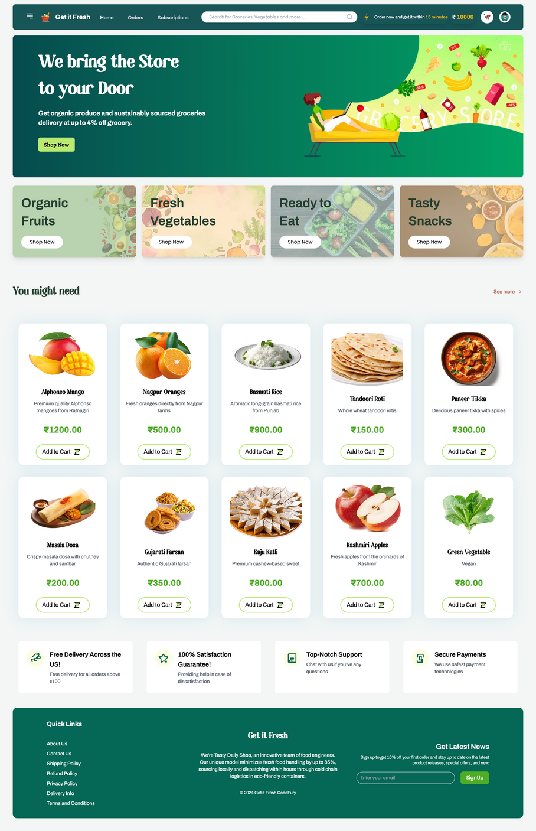
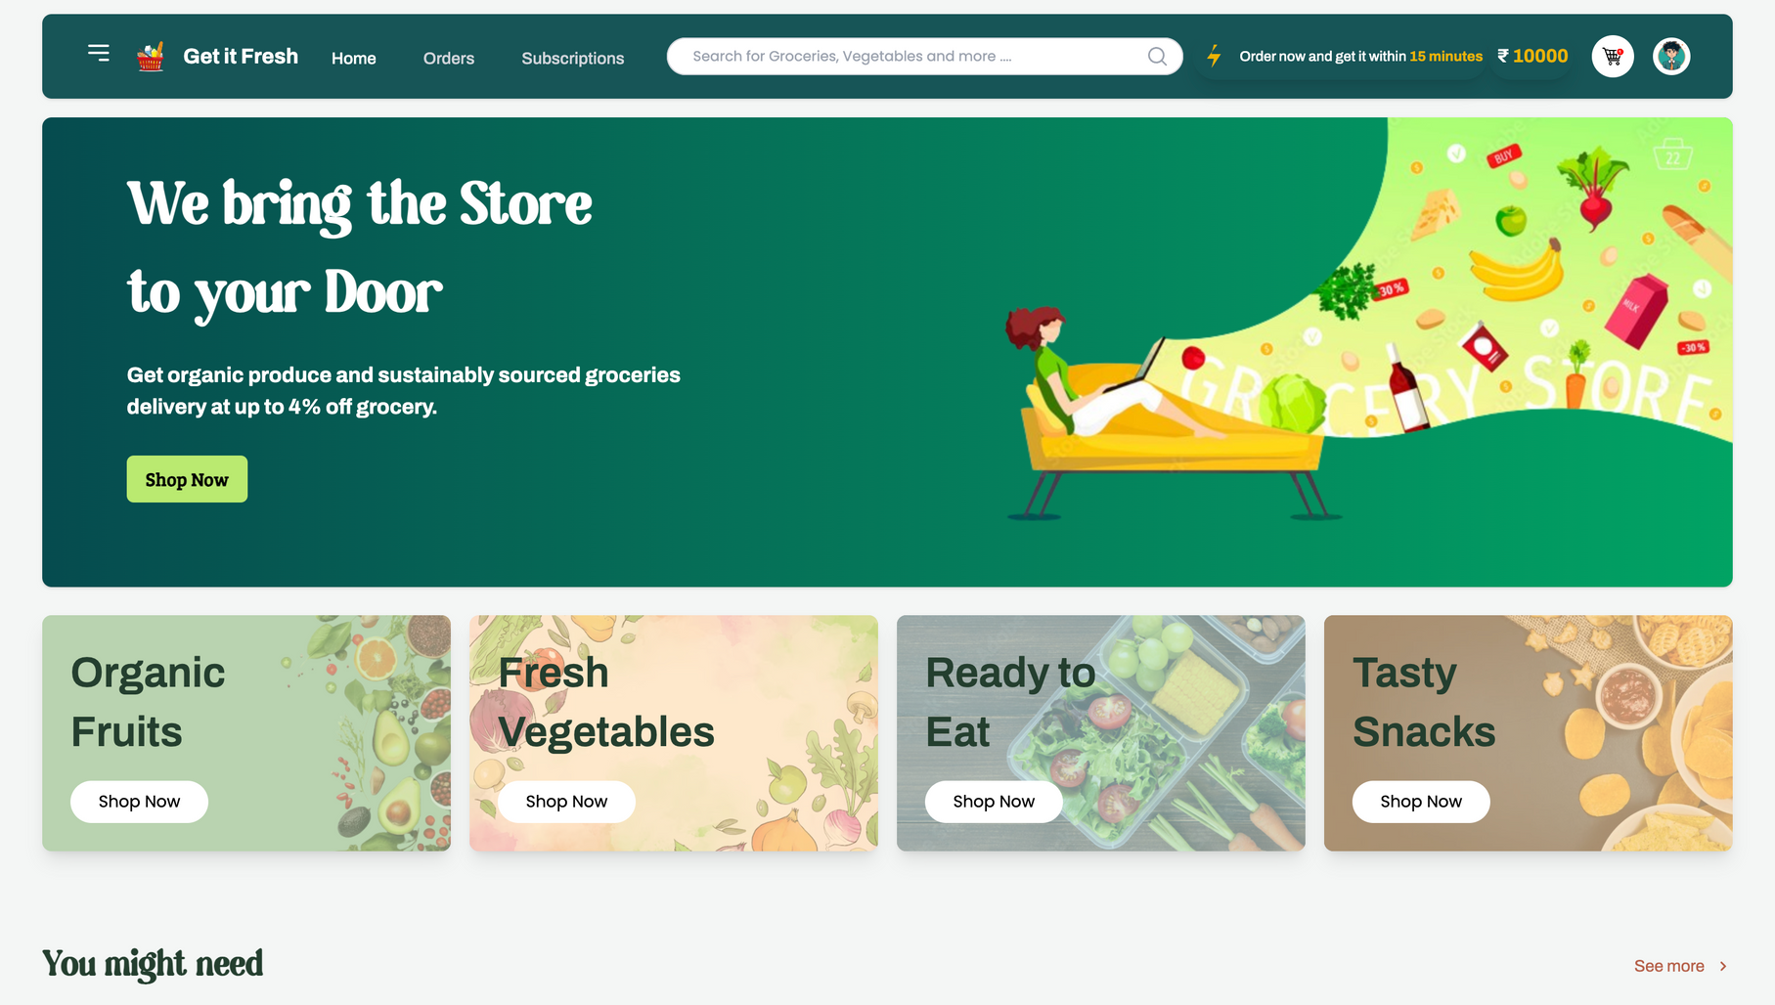



UI Snapshots
Landing Page
Home Page

Slide 7
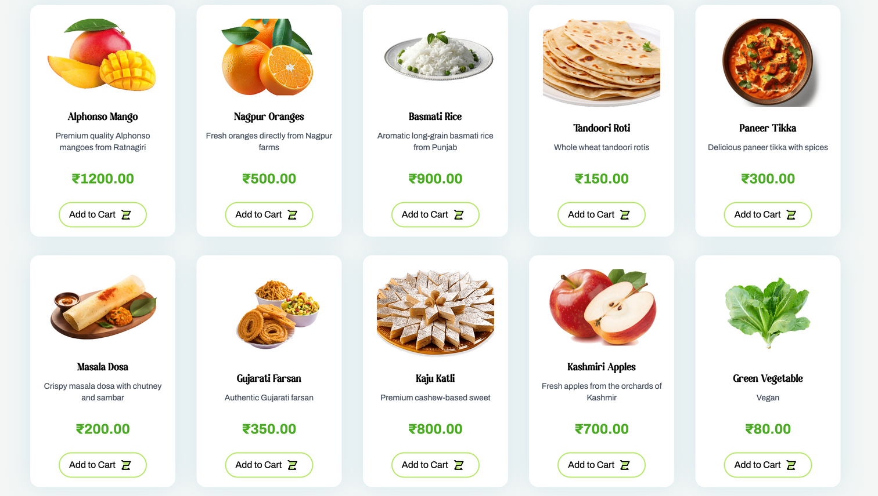
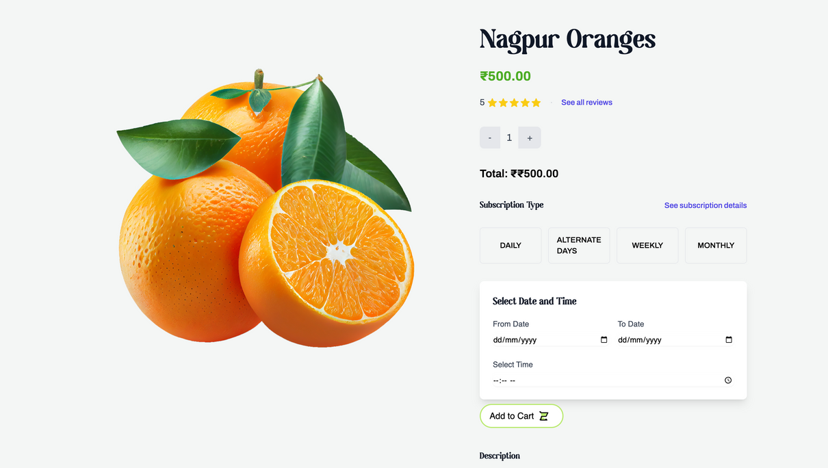
UI Snapshots
Product Catalogue
Product Description

Slide 8
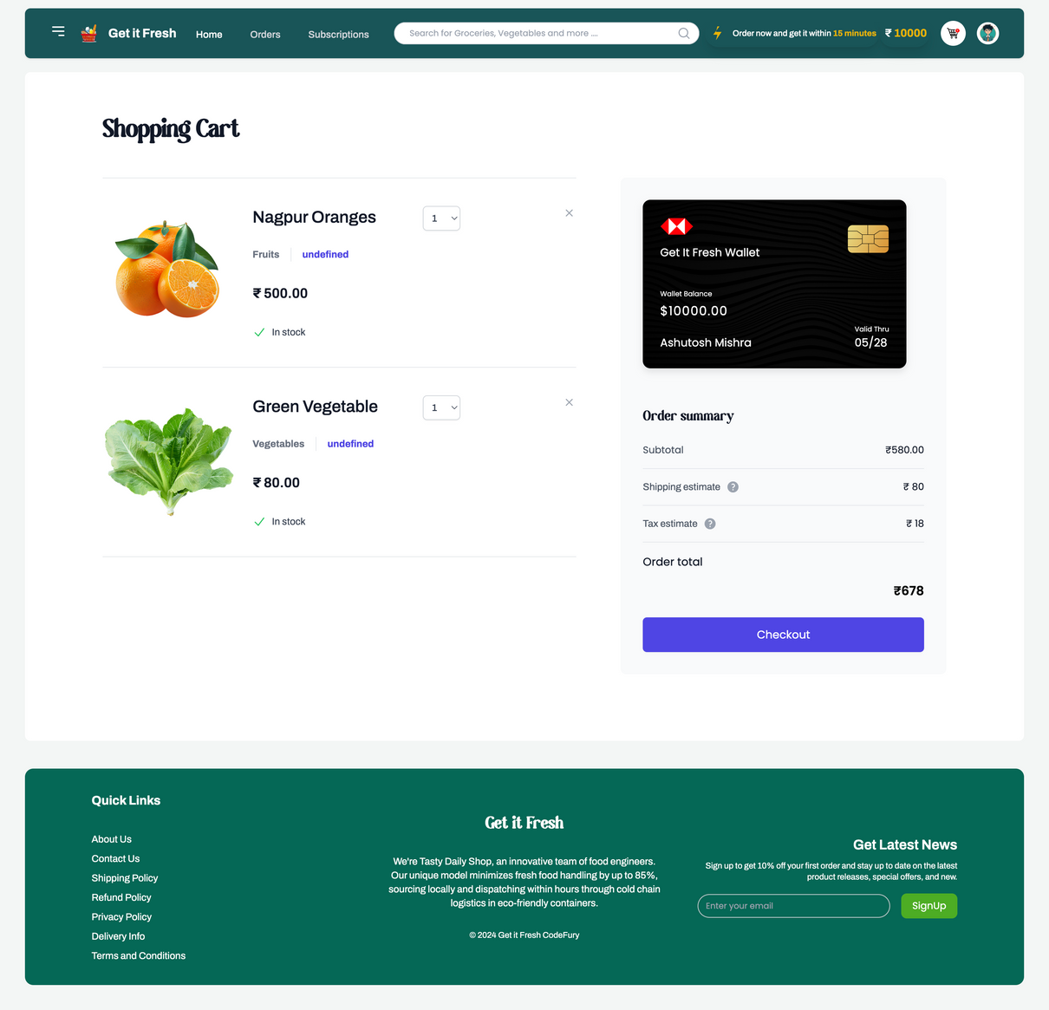
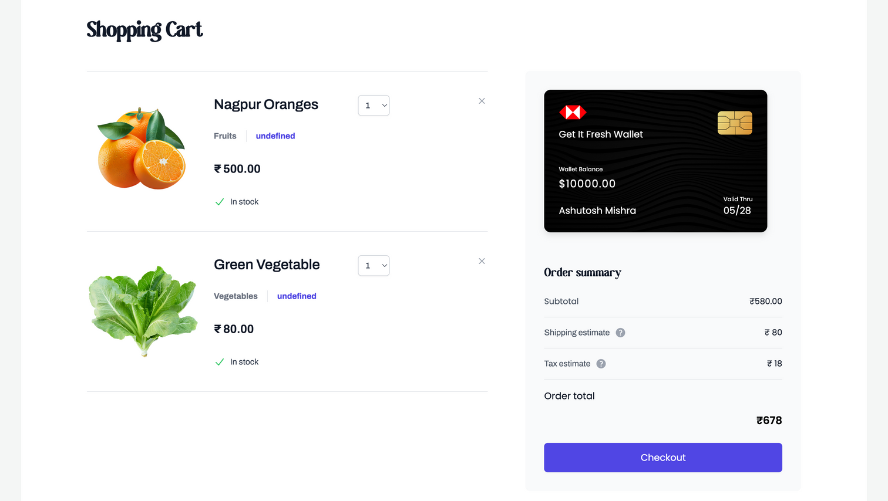
UI Snapshots
Cart Page
Cart Full Page

Slide 9
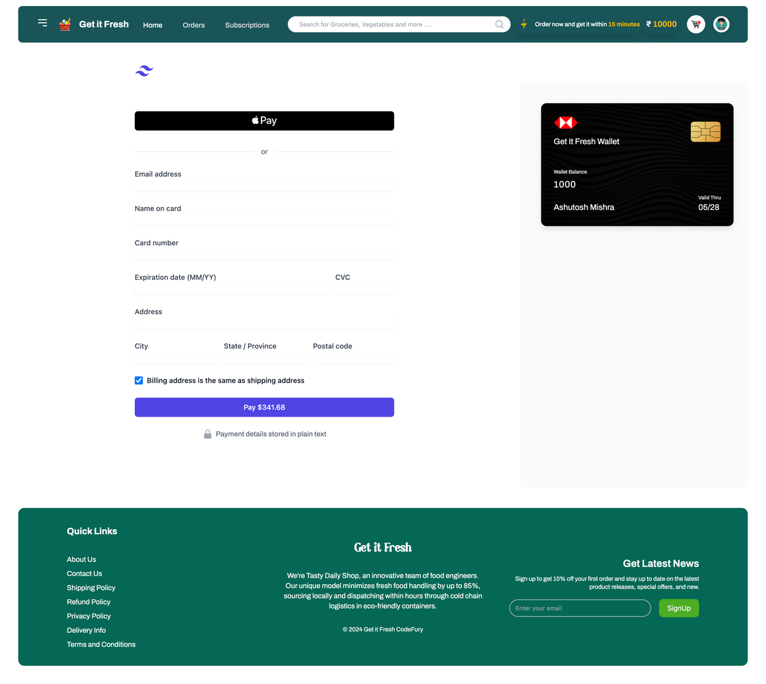
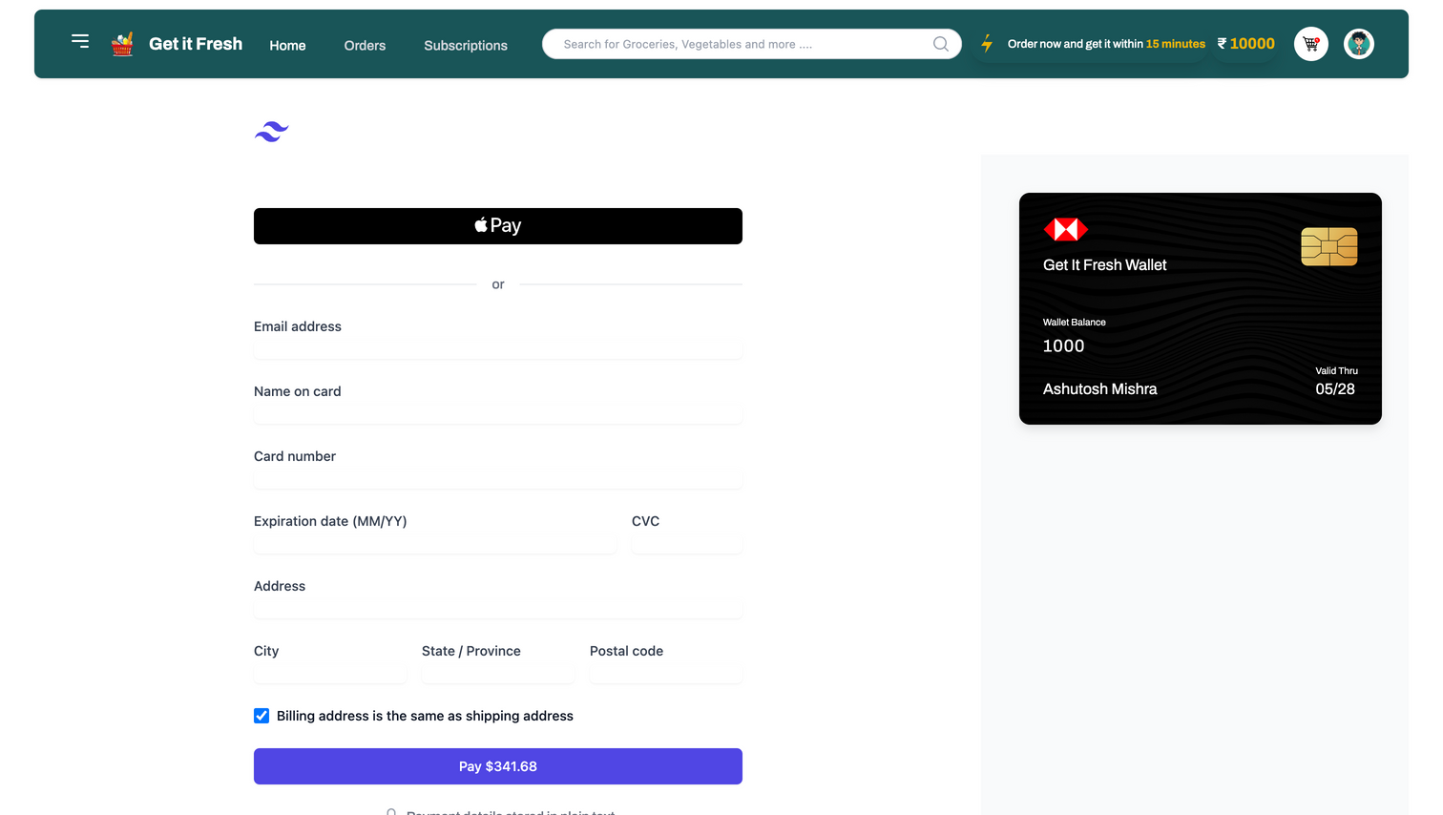
UI Snapshots
Wallet Topup Page
Wallet Full Page

Slide 10
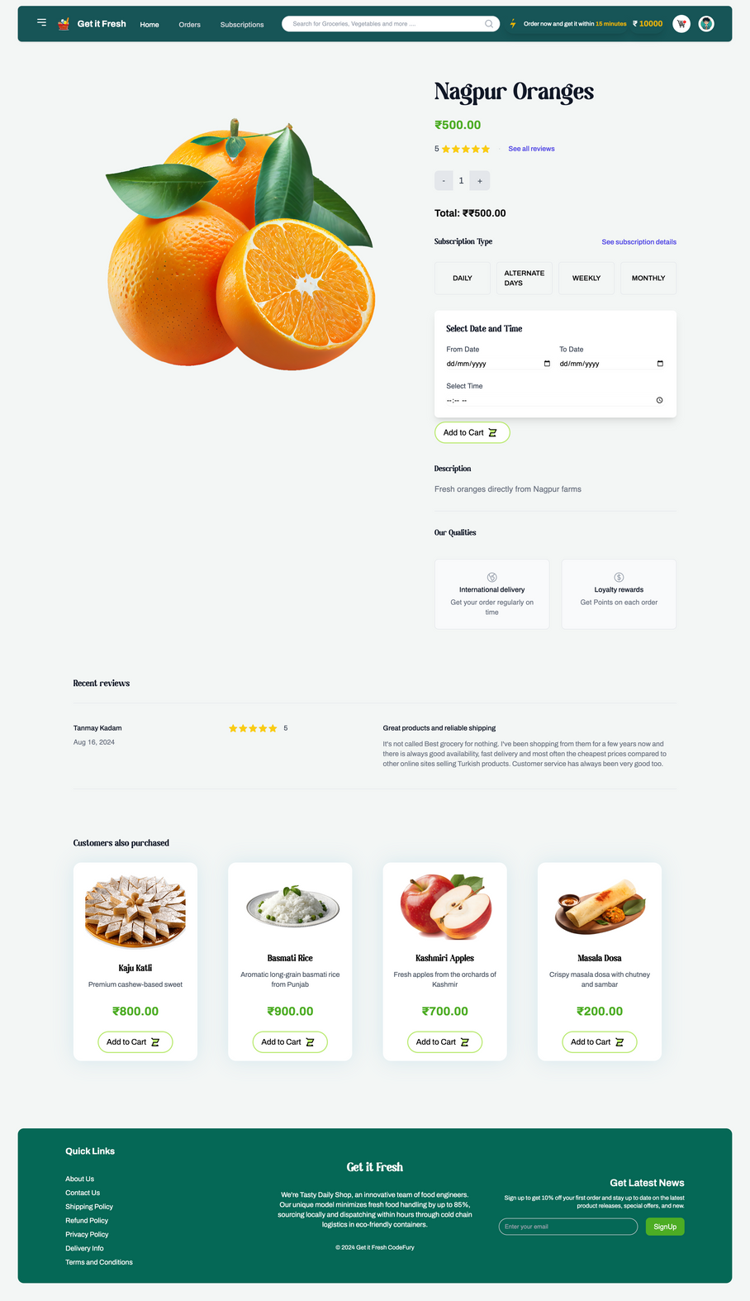
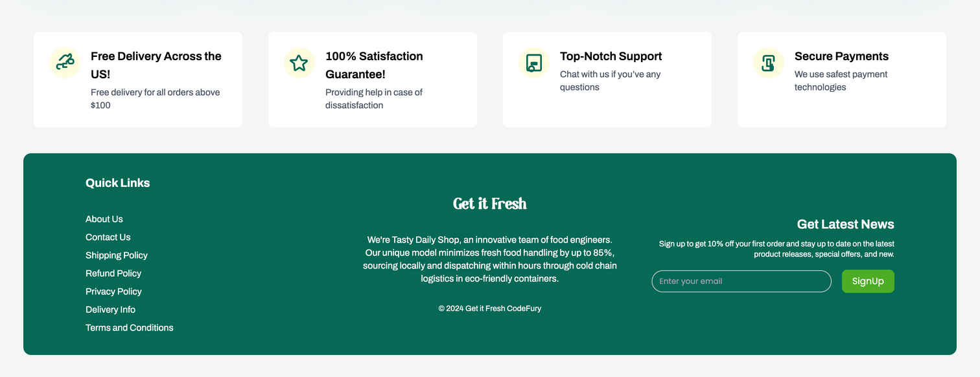
UI Snapshots
Footer Page
Product Full Page

Slide 11
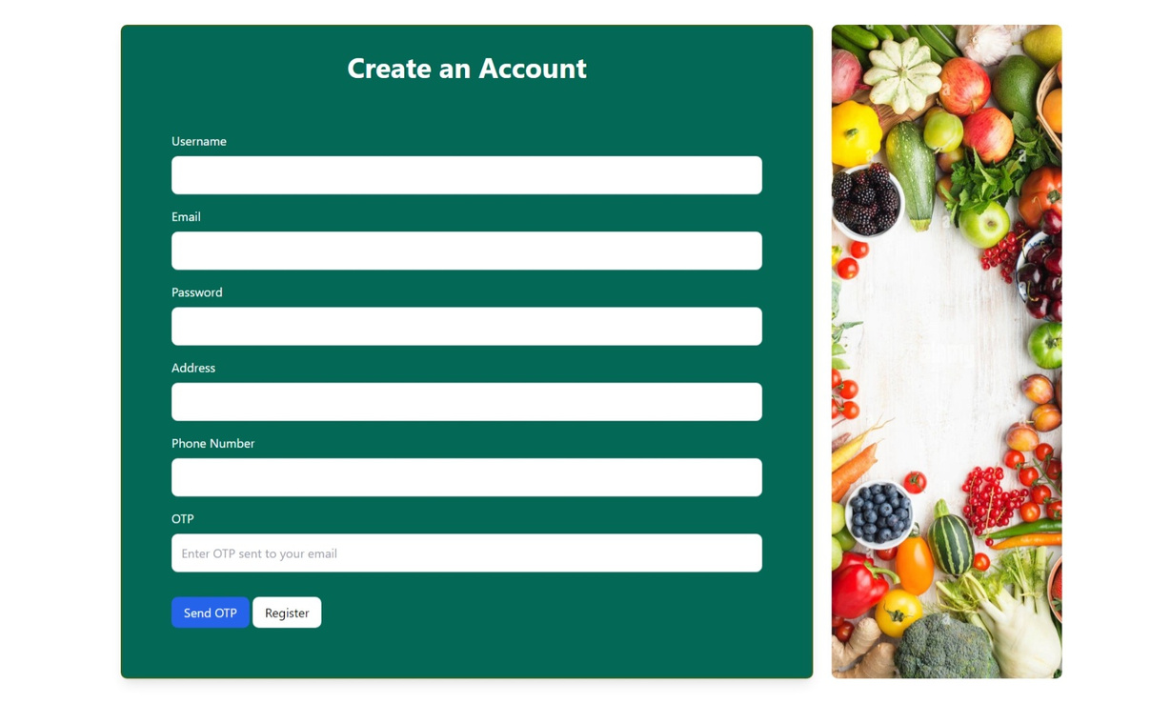
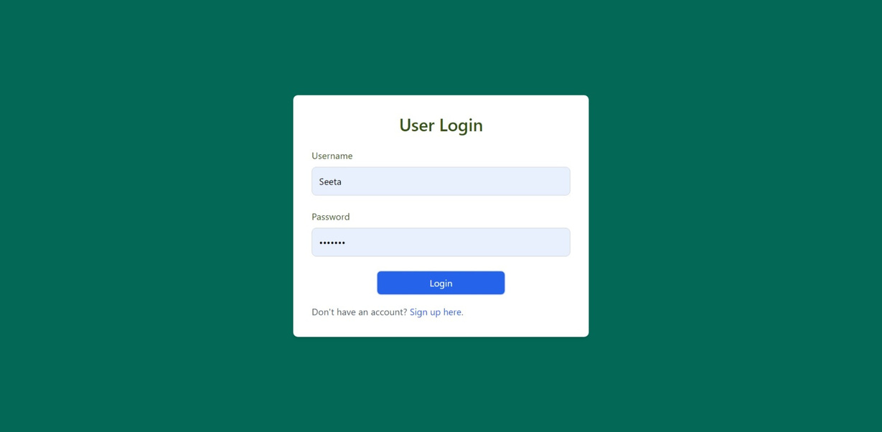
UI Snapshots
Login Page
Registration Page

Slide 12
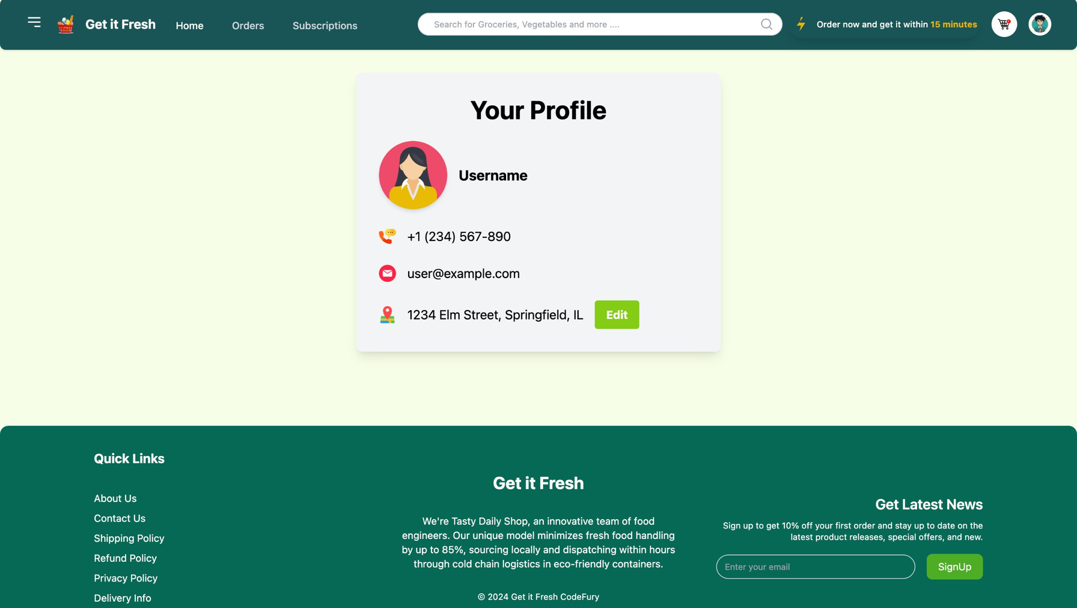
UI Snapshots
Profile Page

Slide 13


Key Learnings
01
Key Concepts: Layered Architecture
02
Tools: Java, HTML,Tailwind CSS, JavaScript
03
Collaboration: GitHub for version control

Slide 14

Thank You!

